Slide 1

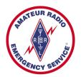
Training Volunteers
The ARRL
Introduction to Emergency Communication Course
EC-001 (2011)
Session One
Notes:
Make sure you have modified the Name and Date.
Display this screen as students are arriving for class.

Slide 2
Reminder
Complete two DHS/FEMA Courses
IS-100.b Introduction to ICS
IS-700 National Incident Management System
Http://training.fema.gov/IS/NIMS.asp
Notes:
ARRL conditions!
The two ICS courses must be complete before taking the final exam.

Slide 3
Session One Topic
Session 1 – Topics 1, 2, 3, 4, 5a, 5b
Session 2 – Topics 6, 7a, 7b, 7c, 7d, 8, 9, 10
Session 3 – Topics 11, 12, 13, 14, 15
Session 4 – Topics 16, 17, 18, 19, 20
Session 5 – Topics 21, 22, 23, 24, 25, 26, 27
Session 6 – Topics 28, 29, Summary, Final Exam
Notes:
The course requires a total of 18 hours.
If a student misses one class they can take a practice quiz for each lesson missed.
A student missing two sessions will be asked to take the course again.
A student missing the last session must wait for the next class and attend the final session for taking the exam again.
An exception would be two Field Examiners agreeing to give the exam at a mutually scheduled time.

Slide 4
Topic 3 - Network Theory and the Design of Emergency Communication Systems

Slide 5
Network Theory
During an emergency
Messages vary greatly in terms of length, content, complexity, and other characteristics
Available communication pathways vary in how well they handle messages having different characteristics
Network theory is the process of matching
a particular message to the
best communication pathway
Notes:
The best pathway is that which can transfer the information with the most efficiency, tying up the communication resources the least amount of time, and getting the information transferred most accurately and dependably.
Hams are often invited to participate in emergency services planning, providing communications expertise. By incorporating some fundamental concepts about network theory into the planning of emergency communication systems, we can take advance steps to be sure that efficient and appropriate communication modes are available when the emergency strikes, thus providing a more valuable service to the public.

Slide 6
Single versus Multiple Destinations
Broadcasting and one-to-one (exclusive) communication channels
Some messages are for one single addressee while others need to be received by multiple locations simultaneously
Notes:
And some messages addressed to one destination can be useful and informative to "incidental" listeners, like the National Weather Service.
A specific instruction to a particular shelter manager is a completely different kind of communication than an announcement to all shelters. Yet, it is common to hear these messages on the same communications channel.

Slide 7
High Precision versus Low Precision
Precision is not the same as accuracy
All messages must be received accurately
List of names or numbers requires precision
"the lost hiker has been found" does not require precision
Over low-precision communications channels (voice modes) even letters of the alphabet can be misinterpreted
Phonetic system, feedback, or error-correcting mechanism

Slide 8
Precision and Message Handling
Precision is a point of confusion in message handling
Not all messages need high precision
Sending a message that needs low precision using formal high precision methods will waste time
Tactical messages can be low precision
Formal message traffic needs high precision
ICS-213 forms
May be high or low precision depending upon content
If you are not sure – ask the originator

Slide 9
Complexity
Which of these is a more complex message?
A doctor at a hospital may use a radio to instruct an untrained field volunteer how to splint a fractured leg
A shelter manager may report that he is out of water
Long and complicated messages
Recipient cannot remember or comprehend the entire message upon its arrival
Detailed maps, long lists, complicated directions, and diagrams
Hard copy or electronic storage for later reference
Fax, email, and packet radio provide this

Slide 10
Timeliness
Some messages are extremely time-critical
Others can tolerate delays without adverse effect
Relief workers/communicators are very busy people
Handling non-time-critical messages may prevent them from handling a more pressing emergency
Highly time-critical messages must get through without delay
Timeliness includes the establishment of a communications link
Total elapsed time from the time the message originates to the time it is delivered to its final party
Notes:
Also, a message might need to be passed at a time when the receiving station is tied up with other business, and by the time the receiving station is free the sending station is then occupied. In these cases, provision can be made for "time shifting:" — the message can be left at a drop point for pickup when the receiving station becomes free.
Timeliness also relates to the establishment of a communications link. Some modes, such as telephones, require dialing and ringing to establish a connection. An operator of a base station radio may need to track down a key official at the site to deliver a message. What matters is the total elapsed time from the time the message originates to the time it is delivered to its final party.

Slide 11
Priority
QSK
Ability to "break in" on a communication in progress
Example: communication pathway is in use with a lengthy, but low-priority, message. A need suddenly arises for a high-priority message
Can the high-priority message take precedence and interrupt the low priority one to gain access to the channel?
Some communications modes allow for this; others do not

Slide 12
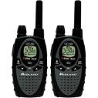


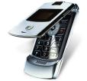



Characteristics of Communication Channels
Consider the communication channels that might be used in an emergency

Slide 13
Telephone
Surprisingly reliable one-to-one communication pathway
Ideal for messages containing sensitive or confidential information, such as casualty lists
No specialized communication training required
Localized and small-scale emergencies
Operational with plenty of unused capacity
Large-scale disasters
Complex central switching and control system can quickly become overloaded
Power
Very good for transferring simple information requiring low precision
Notes:
Since this mode utilizes the human voice, transferring a large amount of high-precision data (such as spelling a long list of names or numbers) can become tedious and time consuming.
But, the one-to-one relationship between sender and receiver makes it ideal for messages containing sensitive or confidential information, such as casualty lists.
The exclusive nature of most telephone circuits makes it difficult or impossible to break-in on a conversation to deliver a higher-priority message. The need for break-in usually precludes leaving the channel open continuously between two points, resulting in the need to dial and answer each time a message needs to be sent.
The major drawback to telephones during emergency situations is that the sending and receiving stations are not self-contained. The system requires wires and cables that can be damaged or destroyed during severe weather. When the central switching center goes down or becomes overloaded, all communications on this mode come to a halt, regardless of priority or criticality.

Slide 14
Cellular Phone
Simple to operate - dose not require a licensed communication volunteer
Ideally suited to one-to-one communications
Lightweight and can be carried in a pocket
Reliant on a complex central switching and control system that is subject to failure or overloading
Designed for busy hour capacity, limited battery life
There is no "go to simplex" contingency option with cellular phones
Unlike landline, cellular phones have RF issues…

Slide 15
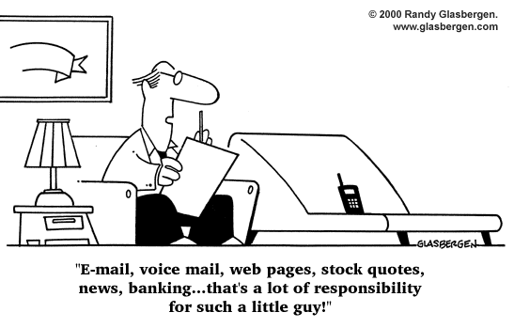

Slide 16
FAX
Fax machines are widely available
Computers modems can send and receive fax
High-precision, lengthy, and complex information
Four-page list of first-aid supplies can be faxed much faster than it can be read over a voice channel and transcribed
Permanent record of the message as part of the transfer process
Rely on the phone system, and add one more piece of technology and opportunity for failure
Most require 120Vac
PC to PC?
Notes:
It is becoming more and more likely that a fax machine will be found at the school, church, hospital, government center, or other institution involved in emergency or disaster-relief efforts. Most of today's computers (even laptops!) are equipped with modems that can send and receive fax information.

Slide 17
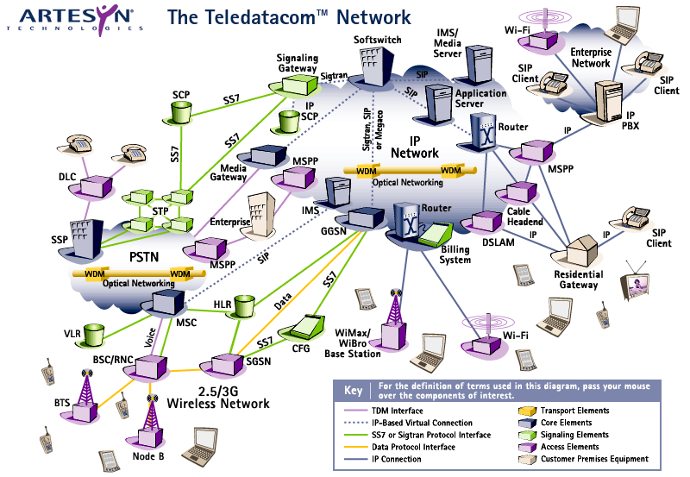
The Telecom Network
http://www.artesyncp.com/resources/teledata/

Slide 18
Two-Way Voice Radio
Simple and easy to operate
Public service bands or ham frequencies, whether SSB or FM, via repeater or simplex
Operate on multiple frequencies
Generally self-contained, enhancing portability and increasing reliability of the system in adverse environmental conditions
Ideal for broadcasting
However, while a message is being transferred between two stations, the entire channel is occupied, preventing other stations from communicating
Using radio for one-to-one communication can be very distracting to stations not involved in the exchange
Low precision inherent in voice modes of communication
Notes:
Most units can operate on multiple frequencies, making it a simple matter to increase the number of available communication circuits as the need arises.
The most common example of inefficient use of communication resources is a lengthy exchange between two stations on a channel being shared by a large number of users.

Slide 19
Trunked Radio
Conventional system, frequencies (channel) are allocated for use by function
Dispatch, car-to-car, tactical, mutual aid, etc.
In a trunk radio system, all users share a pool of frequencies
Notes:
Users are assigned a "group id" and field radios are programmed to only pick-up transmissions for that group. A computer, called the "site controller", automatically assigns a frequency for users belonging to the same group to communicate with each other. This is done over a data channel called the "control channel", which carries data that tells field radios what frequency they are on. Trunk radio systems may have one or more control channels and may rotate them every 24-hours.
Since communications on a trunked system never stay on one frequency, monitoring these communications with a conventional scanner is virtually impossible, especially in large metro areas where a trunked system can have dozens and dozens of users. Although, theoretically, in a small town system with just a couple of users like police and fire and little radio traffic, you could get by using a conventional scanner by programming all system frequencies and locking out the data channels. Although you will have to guess at who is who when you hear something.

Slide 20
Trunked Radio Systems
Highly popular with public service agencies
Fundamental purpose behind trunking …
Allow increased message density on fewer circuits
But when an emergency strikes and communication needs skyrocket, the channels quickly become saturated
Notes:
In other words, more stations could share fewer frequencies, with each frequency being utilized at a higher rate. Under everyday circumstances, this results in more efficient spectrum use.

Slide 21
Talkgroup
On conventional radio systems, frequencies are allocated according to channel use, i.e., one frequency for dispatch, one for car-to-car use, one for mutual aid use, etc.
On trunked radio systems, a different method for identification is used since any frequency can be used by any agency on that system
“Talkgroup” is analogous to “channel”
This method involves the use of various numbers called "trunking IDs" or "talkgroups IDs" used to identify different agencies and their uses

Slide 22
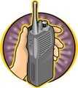
Trunked Radio System
Conventional System
Message on Channel 1 same frequency
Reply on Channel 1 same frequency
If the system uses a repeater, then Tx and Rx are different frequencies but do not change
Trunked System
Message on Talkgroup 1, uses frequency 1
Reply on Talkgroup 1, uses frequency 6
Next message on Talkgroup 1, uses frequency 3
Next reply on Talkgroup 1, uses frequency 8
The frequencies are entirely random within the system and dependent upon which frequencies are available at that exact moment

Slide 23
Digital Trunked Radio System
APCO Project 25, or “P-25”
Public safety industry standard developed by the Association of Public Safety Communications Officials
Interoperability according to a public safety industry standard and not by system manufacturer
Coordinate communications with other agencies and jurisdictions
Purchase radios and other equipment from more than one vendor
Upgrade or migrate systems without replacing all your equipment
Share resources with other organizations to control costs

Slide 24
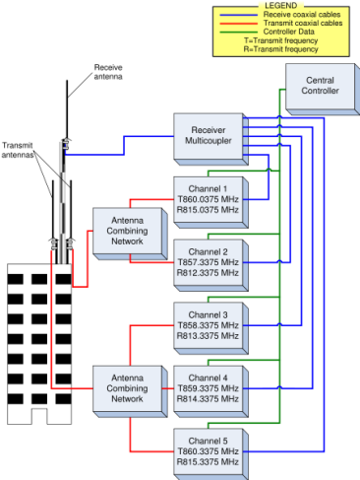
Trunked Radio Systems
Trunked systems rely on a complex central signaling system to dynamically handle the mobile frequency assignments
If the central control unit goes down, the entire system — base and mobile units — must revert to a pre-determined simplex or repeater-based arrangement
Risky in emergency situations because of the small number of frequencies available to the system

Slide 25
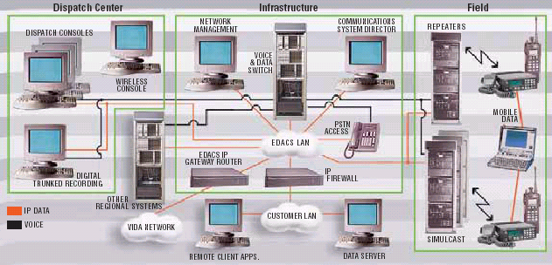
Example Trunked System
http://www.macom-wireless.com/news/EDACS_VIDA.pdf

Slide 26
Packet Radio
Facilitate high-precision message transfer
Near-perfect accuracy in transmission and reception
No need for a conversion step before transmission
Generally self-contained
Perfect for the distribution of high-precision information to a large number of destinations simultaneously
Real-time packet messages require the operator to use a keyboard
Common packet protocols are inefficient when transferring precision graphics, drawings, and all but the most rudimentary maps
May not be reliable along marginal RF paths
Notes:
The packet mode has another advantage when dealing with information that is in electronic form: there is no need for a conversion step before transmission. This is especially valuable when the information being sent is generated by machine (such as automated weather sensors, GPS receivers, or shelter management computers).

Slide 27
Store-and-Forward Systems
Bulletin boards, messaging gateways, electronic mailboxes, etc
Subset of packet radio
Non-time-critical messages and reference material
Good for when sender and receiver cannot be available simultaneously
Not limited to digital modes
Voice-answering machines,
NTS-like arrangement of liaison stations can function as voice-based store-and-forward systems

Slide 28
Winlink and D-Star
In a nutshell
Packet
Email
Attachments
Internet

Slide 29
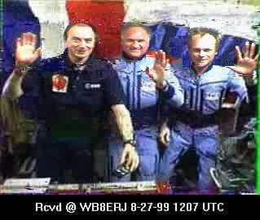

Other Modes
Slow-scan television
Fast-scan television
Satellite communications
Human couriers
Internet
Email
IRLP, Echolink
Notes:
Space limitations prohibit more discussion, but by now you get the idea of how communications channels relate to different types of messages.

Slide 30
Planning and Preparation
Give advance thought to the kinds of information that might need to be passed during each kind of emergency
Will maps need to be transferred?
What about long lists of names, addresses, supplies, or other detailed identification?
Will the communications consist mostly of short status reports?
Will the situation likely require transfer of detailed instructions, directions, or descriptions?
Will they originally be in verbal, written, or electronic form?

Slide 31
Planning and Preparation
Consider the origins and destinations of the messages
Will one station be disseminating information to multiple remote sites?
Will there be a lot of one-to-one messages?
Will one station be overloaded while others sit idle?
Will a store-and-forward system, even via voice, be useful or necessary?

Slide 32
Planning and Preparation
Content of the messages should also be considered
Will a lot of confidential or sensitive information be passed?
Will there be a need for break-in or interruption for pressing traffic or can one station utilize (tie up) the communications link for a while with no adverse consequences?

Slide 33
Planning and Preparation
Most important step:
Take action to increase the likelihood that the needed modes will be available during the emergency …

Slide 34
Planning and Preparation
“Jump kit" emergency packs contain 2-meter radios, extra batteries and roll-up antennas
How about doing the same thing for some additional communication modes, too?
Put a list of critical phone numbers (including fax numbers, pager numbers, cellular numbers) in your kit.
Make sure your local packet digipeater has battery backup.
If you are likely to be assigned to a school, church, or office building, see if you can get a copy of the instructions for using the fax machine to keep in your kit.
If the phones are out, know how to interface the fax machine to your radio.

Slide 35
Planning and Preparation
Advance scouting
It is a good idea to see if fax machines are in place and whether they will be accessible in an emergency.
Is there a supply of paper available?
Are the packet digipeaters within range of every likely communication post?
Can computers be made available or will hams have to provide their own?
How will backup power be provided to the computers?
Can a frequency list be developed, along with guidelines of when and how to use each frequency?

Slide 36
Planning and Preparation
Contingency planning = critical importance
How many times has a repeater gone down, and only then did the communicators wish they had agreed in advance on an alternate simplex frequency?
What will you do if you need to send a map and the fax machine power fails?
Suppose you are relying on cellular phones and the cellular network fails?
Remember, if you plan for problems, they cease to be
problems and become merely a part of the plan.

Slide 37
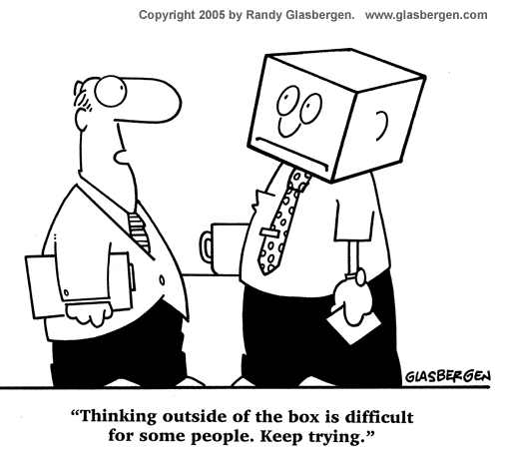

Slide 38
Training
Manning roster, assignment lists, and contingency plans
Tied in to the training and proficiency
Questions you might want to ask are:
Who knows how to use a cellular phone?
Who knows how to use fax software?
Who knows how to upload or download a file from a packet BBS?
Who knows how to touch-type?
A little advance planning and effort can go a long way to
turning a volunteer mobilization into a versatile, effective,
professional-quality communication system

Slide 39
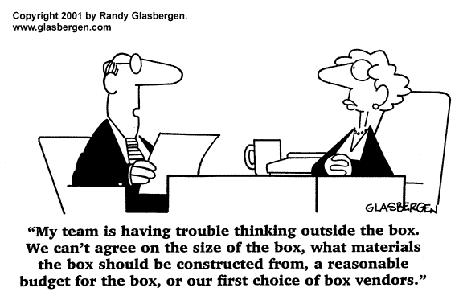

Slide 40
Summary
Any questions before the quiz?

Slide 41
Time for a Quiz
Take 30 Seconds adjust your workspace

Slide 42
30
Seconds

Slide 43
20
Seconds

Slide 44
10
Seconds

Slide 45
9
Seconds

Slide 46
8
Seconds

Slide 47
7
Seconds

Slide 48
6
Seconds

Slide 49
5
Seconds

Slide 50
4
Seconds

Slide 51
3
Seconds

Slide 52
2
Seconds

Slide 53
1
Seconds

Slide 54
Let's get started!

Slide 55
Topic 3 Question
What mode should be used to send a list of casualties?
VHF repeater system
A secure mode
Packet radio
An HF net

Slide 56
Topic 3 Question
What types of messages are good to send by fax?
High precision, lengthy and complex messages
Simple low-precision, and short messages
Messages to many destinations simultaneously
High detail color photographs

Slide 57
Topic 3 Question
What types of messages should be handled by a packet bulletin board system?
Time sensitive messages of immediate priority
Low precision messages
Non-time-critical messages and reference material, when the sender and receiver cannot be available simultaneously
Messages to be "broadcast" to numerous stations

Slide 58
Topic 3 Question
What is the pitfall that is common to telephone, cellular phone and trunked radio systems?
They do not take advantage of the benefits of Amateur Radio
They are all difficult to use
They are seldom available at shelters and public safety agencies
They all require the use of a complex central switching system that is subject to failure in a disaster situation

Slide 59
Topic 3 Question
Which of the following is an example of an efficient communication?
A ham communicating a lengthy list of needed medical supplies over a voice net
A lengthy exchange between two stations on a primary voice net channel being shared by a large number of users
Typing out a digital message that "the delivery van containing the coffee has arrived at this location" on a high-precision packet link
Sending a shelter list on the office fax machine

Slide 60
B r e a k
10 Minutes

Slide 61
10
Minutes

Slide 62
5
Minutes

Slide 63
2
Minutes

Slide 64
1
Minute

Slide 65
50
Seconds

Slide 66
40
Seconds

Slide 67
30
Seconds

Slide 68
20
Seconds

Slide 69
10
Seconds

Slide 70
9
Seconds

Slide 71
8
Seconds

Slide 72
7
Seconds

Slide 73
6
Seconds

Slide 74
5
Seconds

Slide 75
4
Seconds

Slide 76
3
Seconds

Slide 77
2
Seconds

Slide 78
1
Seconds

Slide 79
Let's get started!

Slide 80
Any Questions Before Starting Topic 4?

